Slide 1
Bank-Marketing Analysis Name: Bhagyshri Madnure

Slide 2
AGENDA
Overview
What is Bank Marketing Analysis?
Dataset Summary
Scope of the project
Libraries Used
Data Visualization
Machine Learning
conclusion

Slide 3
Overview
The process by which companies create value for customers and build strong customer relationships in order to capture value from customer in return.
The data is related to marketing campaigns bades on phone calls.

Slide 4
What is Bank Marketing?
Prediction of the results of the marketing campaign for each customer and clarification of factors which affect the campaign results. This helps to find out the ways how to make marketing campaigns more efficient. Finding out customer segments, using data for customers, who subscribed to term deposit.

Slide 5
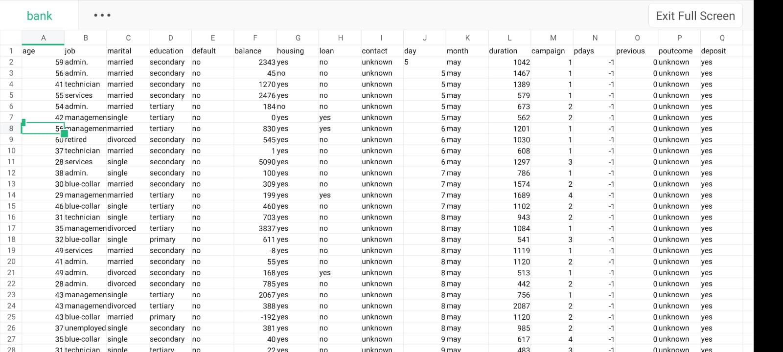
Dataset Summary
The dataset contains information on bank customers likewise age, job, marital status, education, default balance, housing loan, contact, day, month, duration campaign, pdays ,previous ,deposite etc.

Slide 6
Scope of the project
The project aims to helps to find out the ways how to make marketing campaigns more efficient. Finding out customer segments, using data for customers, who subscribed to term deposit. This helps to identify the profile of a customer, who is more likely to acquire the product and develop more targeted marketing campaigns.

Slide 7










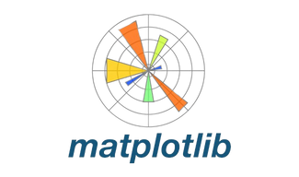




Libraries Used
Numpy
Seaborn
NumPy is a key Python library for numerical computing, enabling efficient manipulation of large arrays and matrices, along with comprehensive mathematical functions.
Seaborn is a statistical data visualization library in Python built on top of Matplotlib, providing high-level interface for drawing attractive and informative statistical graphics.
Pandas
Pandas is a powerful Python library for data manipulation and analysis, offering data structures and tools for handling structured data effectively.
Matplotlib
PYTHON LIBRARIES
Matplotlib is a python library used for creating static and interactive visualizations, offering extensive customization options for data analysis and presentation.
SkLearn
Scikit-learn is a powerful machine learning library in Python, offering tools for various tasks like classification, regression, clustering, dimensionality reduction and more with efficient algorithms and a user-friendly interface.
Warnings
Mpl_toolkits
Warnings library in Python enables developers to issue and manage warning messages, aiding in the detection of potential issues or deprecated features during program execution.
MPL_Toolkits enhances Matplotlib with extra tools and plot types, broadening its capabilities for diverse visualization tasks.

Slide 8

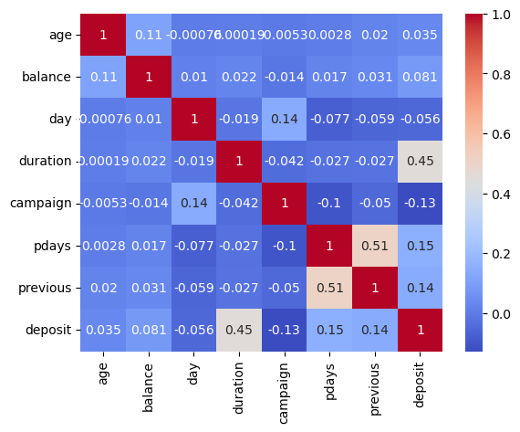
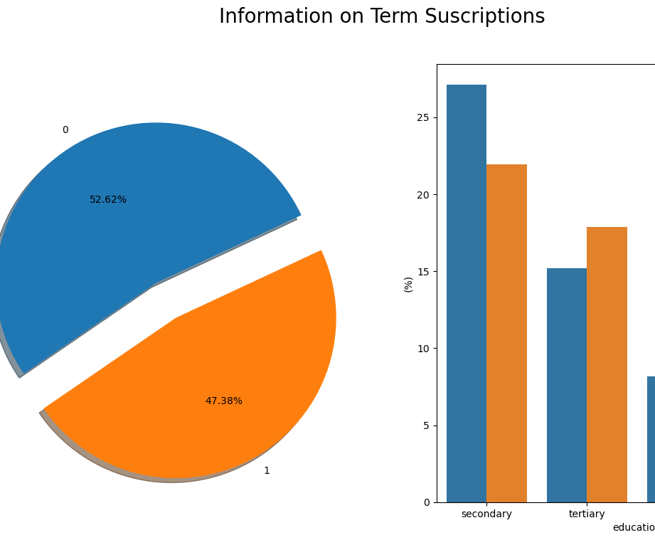
Data VIsualization
Bar Plot:
A bar plot (or bar chart) is a data visualization technique that uses rectangular bars to represent categorical data.
Sub Plot:
Subplots allow you to create multiple plots within the same figure, providing a way to compare and visualize different aspects of data.

Slide 9
Machine Learning
The machine learning aspect of the project involves the following algorithms:
KNN Score - 0.1919
Random Forest Score – 0.1418
K-Nearest Neighbor Algorithm 95.70 % in predicting the stroke prediction dataset used whereas Random forest 94.80%.
Random forest is better than K-nearest neighbor.

Slide 10
Conclusion
In conclusion, the project demonstrates the utility of machine learning techniques in default payments based on customer attributes and payment histories. By leveraging the insights gained to inform and improve future marketing initiatives.

Slide 11
THANK YOU!

